Slide 1

In Pursuit of the Holy Grail of Natural Language Understanding: Past, Present, and Future
September 2019
Daniel Khashabi

Slide 2
My Background
Recently finished PhD (UPenn)
Been working with Allen Institute for AI (AI2)
On-and-off since 2015, and full-time since this August
Research theme:
Artificial Intelligence, through the lens of natural language understanding
Not specified:
What solution we use to achieve this goal
Not a CP person!

Slide 3


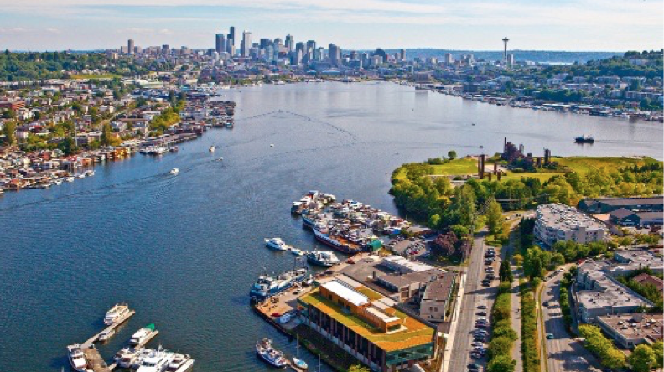
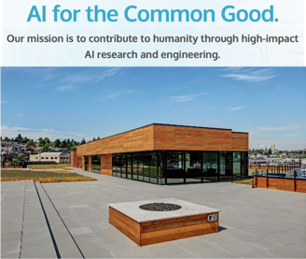
Founded in 2014 by Paul Allen (Microsoft co-founder)
Non-profit research organization
Mission: contribute to humanity through high-impact AI research and engineering
Notes:
mission is to contribute to humanity through high-impact AI research and engineering
what are those projects? (next slide)

Slide 4
Project Aristo (2014-2019)
Vision: The Knowledgeable Machine
Large volumes of general and scientific knowledge, stored in a "computable“ form, supporting reasoning and explanation
Measurable goal:
Pass elementary-school science exams as written
Currently 4th grade and 8th grade exams
Credit goes to dozens of researchers who have contributed to this project.

Slide 5
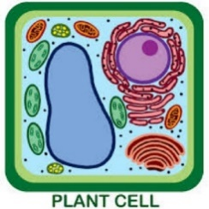
Example Question: Reasoning by Chaining
The cell structure that makes a plant cell more rigid than an animal cell is the (A) cell membrane.
(B) cytoplasm.
(C) cell wall.
(D) ribosome.

Slide 6
Example Question: Reasoning by Chaining
The cell structure that makes a plant cell more rigid than an animal cell is the (A) cell membrane.
(B) cytoplasm.
(C) cell wall.
(D) ribosome.
Plants use cellulose for their cell walls.

Slide 7

Example Question: Reasoning by Chaining
The cell structure that makes a plant cell more rigid than an animal cell is the (A) cell membrane.
(B) cytoplasm.
(C) cell wall.
(D) ribosome.
Plants use cellulose for their cell walls.
All fibers are assembled of chains of
cellulose molecules, arranged as a rigid structure.

Slide 8
Example Question: Reasoning by Chaining
The cell structure that makes a plant cell more rigid than an animal cell is the (A) cell membrane.
(B) cytoplasm.
(C) cell wall.
(D) ribosome.
Plants use cellulose for their cell walls.
All fibers are assembled of chains of
cellulose molecules, arranged as a rigid structure.

Slide 9

Aristo: an over-simplified overview
An ensemble architecture
To deal with questions with a variety of difficulty
Question
ARISTO
Retrieval
& Statistics
Structured Representation
Inference
Solvers
Answer
Web, Science
Combiner (Ensemble)
Text
Deep
Learning

Slide 10
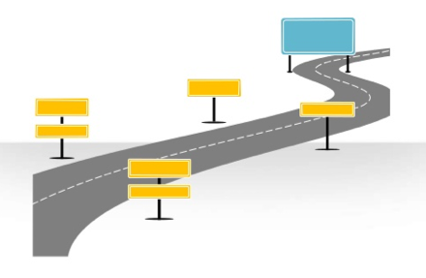
Road map
Aristo Inference Solvers
Beyond inference Modules
Question
ARISTO
Retrieval
& Statistics
Structured Representation
Inference
Solvers
Answer
Web, Science
Combiner (Ensemble)
Text
Deep
Learning

Slide 11
Aristo Inference Modules
Khashabi et al, AAAI-2018
Khot et al, ACL-2017
Khashabi et al, IJCAI-2016

Slide 12

Aristo Inference Modules
General structure of inference frameworks
Text & questions converted to an intermediate representation
A “probabilistic” inference for question-answering
Three key scientific questions:
How do we identify and represent the meaning of text?
What mechanisms support robust reasoning with incomplete and incorrect knowledge?
Knowledge Base
(library of ontologies and domain models)
Tractable, probabilistic
Inference
Text
answer
explanation
, because
Natural Language
Processing

Slide 13
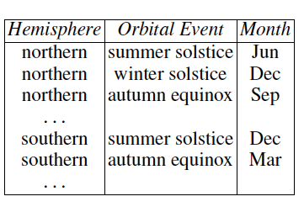
Knowledge in Tabular Representation
Knowledge Base
(library of ontologies and domain models)
Tractable, probabilistic
Inference
Text
answer
explanation
, because
Natural Language
Processing
One giant database of science knowledge
Energy, Forces, Adaptation,
Phase Transition, Organ Function, Tools, Units, Evolution, …
Simple structure, flexible content
Can acquire knowledge in automated and semi-automated ways
No Cyc-like claims of “completeness” or “adequacy”
[Dalvi et al, 2016]

Slide 14


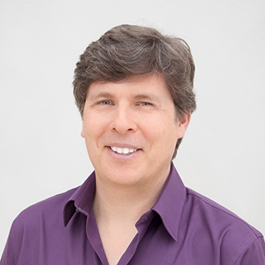
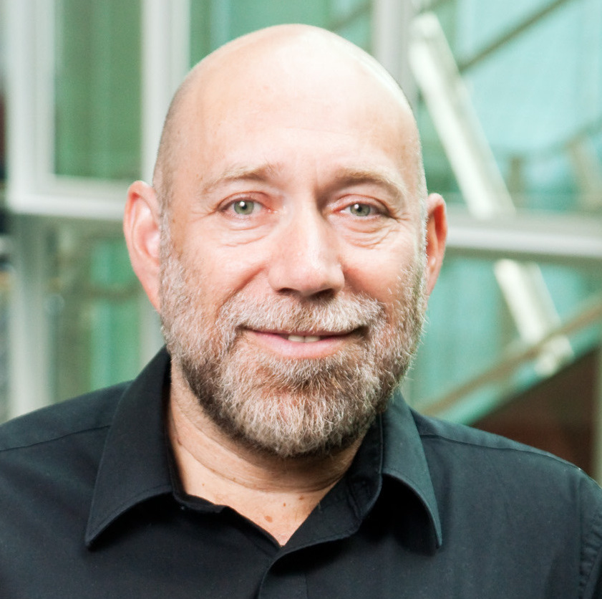
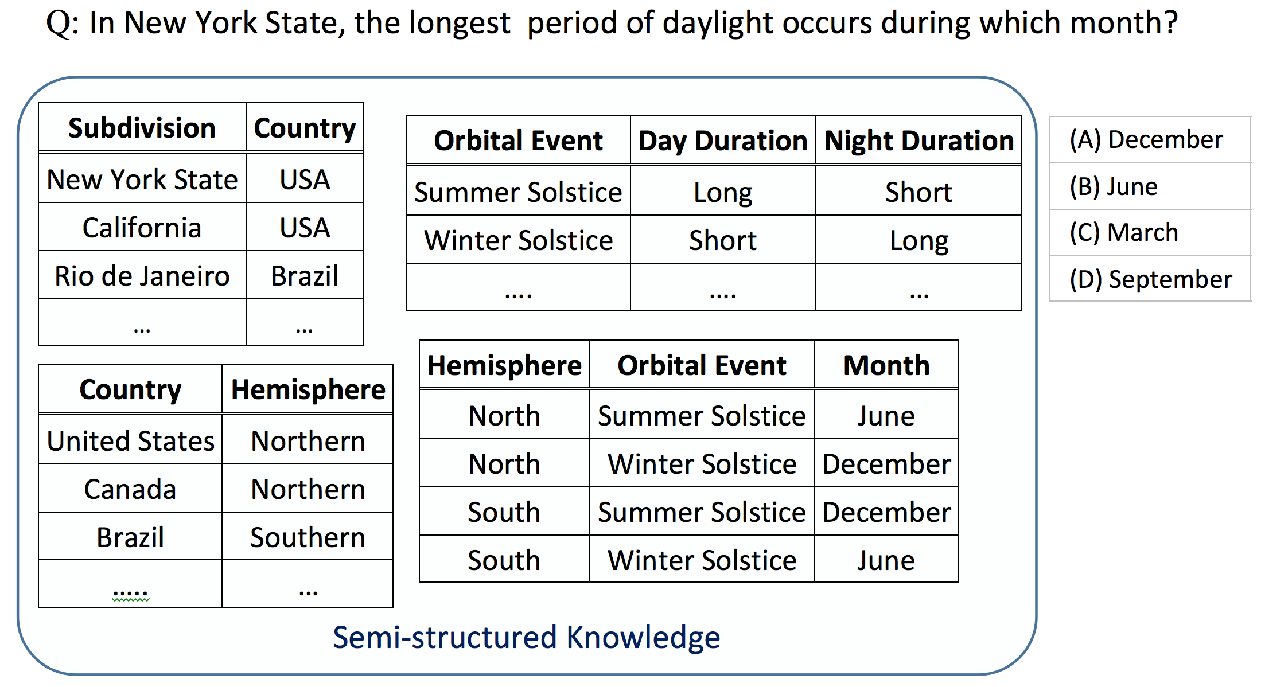
TableILP: Main Idea
Cities, States, Countries
Orbital Events:
Geographical properties & Timing
IJCAI-2016
How is relevant information expressed in my KB?
Potential Link:
Regions and Hemispheres

Slide 15
TableILP: Main Idea
Search for the best Support Graph connecting the Question to an Answer through Tables.

Slide 16
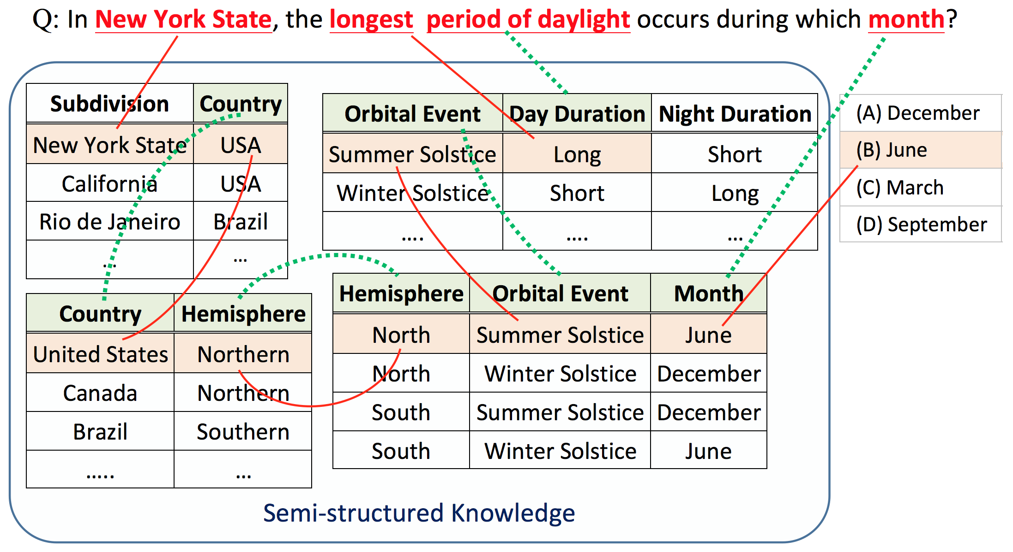
TableILP: Main Idea
Search for the best Support Graph connecting the Question to an Answer through Tables.
Link this information to identify the best supported answer!
Abductive reasoning
[Peirce, 1883]

Slide 17
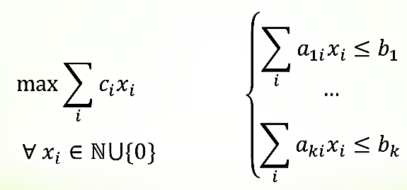
TableILP Solver: Overview
A discrete optimization approach to QA for multiple-choice questions
Question Q with answer options A
ILP model builder
M(T,Q,A)
ILP engine
Knowledge Tables T
Lexical “similarity”
Table Join rules
a_{i} ∈ A with score +
support graph
for words & short-phrases
Optimization using Integer Linear Program (ILP) formalism
M(G,Q,A)

Slide 18
ILP Model: Design Challenges
Goal: Design ILP objective function, s.t. maximizing it subject to the constraints yields a “desirable” support graph
Not our focus ✘
Natural Language (Question, …)
Conceptual def of: Constraints, Objective
ILP CP SAT …
Solution
What we study ✓
Not our focus ✘
Notes:
What are the challenges in formulating such an optimization problem?
It’s not that straight-forward as you might imagine from the previous example. There many proof structures that this definition has to capture:
- The answer might just be a row in a table,
- It could be expressed across multiple tables
- or it could parallel evidence within a table
So we have to come up with flexible-enough design that captures all the variations of such proof structures.
And in addition to this, you have to have mechanism for rewarding the good proofs; but you also have to penalize the system for making spurious connections.
And here you can use the information from lexical similarity box: reward strong links and penalize weak links
But of course, this similarity blackbox is itself is imperfect, as you’d imagine. So you have to compensate for that noise.
Of course you also have to consider question-logic: negations in questions, it might talk about comparisons, etc.

Slide 19
ILP Model: Design Challenges
Goal: Design ILP objective function, s.t. maximizing it subject to the constraints yields a “desirable” support graph
Not so straightforward!
Many possible “proof structures”
Imperfect lexical “similarity” blackbox
Partial or missing knowledge
Question logic (negation, conjunction, comparison)
Scalability of ILP solvers
…
Notes:
What are the challenges in formulating such an optimization problem?
It’s not that straight-forward as you might imagine from the previous example. There many proof structures that this definition has to capture:
- The answer might just be a row in a table,
- It could be expressed across multiple tables
- or it could parallel evidence within a table
So we have to come up with flexible-enough design that captures all the variations of such proof structures.
And in addition to this, you have to have mechanism for rewarding the good proofs; but you also have to penalize the system for making spurious connections.
And here you can use the information from lexical similarity box: reward strong links and penalize weak links
But of course, this similarity blackbox is itself is imperfect, as you’d imagine. So you have to compensate for that noise.
Of course you also have to consider question-logic: negations in questions, it might talk about comparisons, etc.

Slide 20
ILP Model: Some Details
Notes:
I am going to give you a high description of what is going on in this ILP optimization and hopefully that will give you enough intuition about what is going under the hood.
There are three key components that we have to define for this optimization problem: ...

Slide 21
ILP Model: Some Details
Variables define the space of “support graphs”:
Each variable corresponds to to a node or edge.
x=1 iff nodes / edges are part of the semantic graph.
Support Graph
Notes:
The variables of this optimization problems correspond to the nodes or edges of the support graphs (if a variable is on, it belongs to the graph).
Collectively, the variables define the space of all the possible support graphs.

Slide 22
ILP Model: Some Details
Objective Function: “better” support graphs = higher objective value
Reward good behavior:
High lexical match links, nearby alignments, column header match, WH-terms (“which of energy …”), etc.
Penalize spurious overuse of frequently occurring terms
Notes:
And the objective function tries to operationalize the intuition that better support graphs get higher scores.
And in order to do that, we have define all the ways that result in the desired behavior:
Reward:
- Strong links can be rewarded; using table headers is probably a good thing.
- More information used, it’s probably a good thing, but you don’t want spurious links (so you can penalize those).
- You reward alignments to the salient terms in the questions; for example, if the question mentions “which form of energy …”, you better pay attention to energy.

Slide 23
ILP Model: Some Details
Constraints:
~50 high-level constraints
Scalability + consider only meaningful support graphs
Structural Constraints: Many possible Proof Structures:
Basic Lookup, Parallel Evidence, Evidence Chaining, Semantic Relation Matching
Semantic Constraints: Meaningful proof structures
Connectedness, question coverage, appropriate table use, etc.
Notes:
Unlike objective that is about preferences, the constraints enforce hard requirements. They enforce certain properties on local and global structure of the resulting subgraphs.
On the structural side, we want it to be connected, you want to cover the questions,
Or if you’re using parallel evidence proof structure, you have to use the cells that have similar signatures/headers.

Slide 24
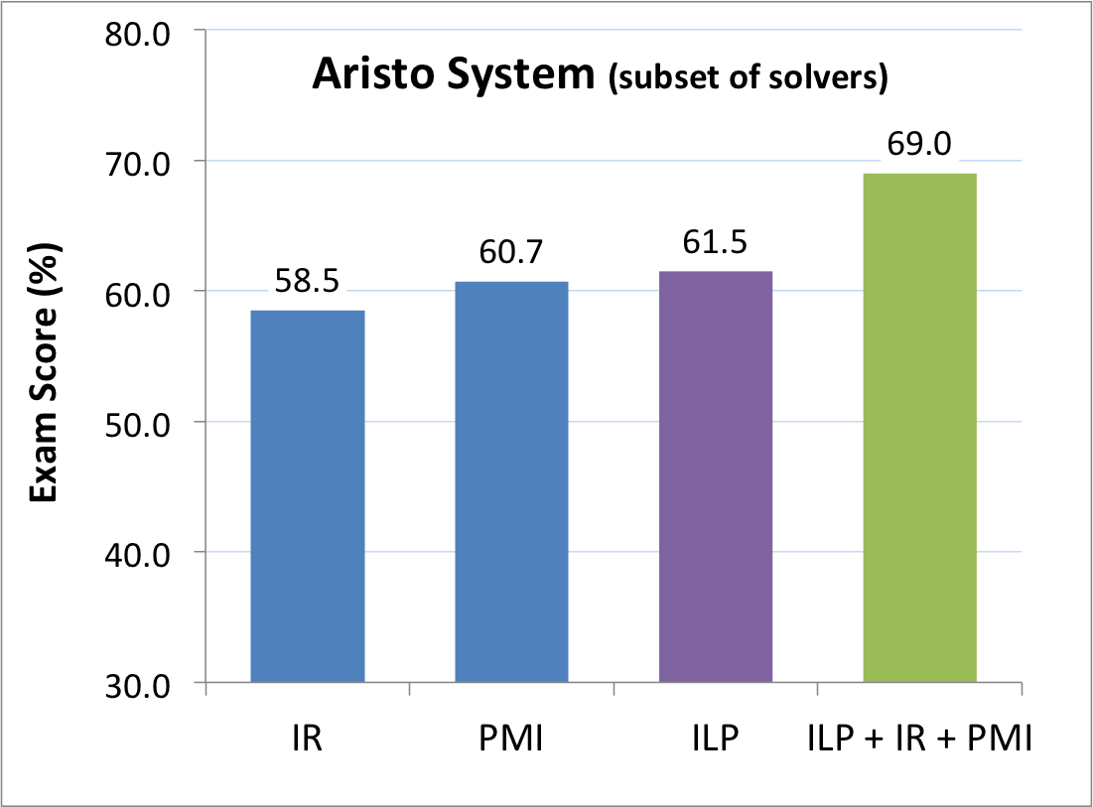
Some Empirical Results
IJCAI-2016
More details in: K et al, IJCAI-2016.
Ensemble performs 8-10% higher than IR baselines

Slide 25
Beyond Tables
Issues with tabular representation:
Hard to extract; the schemas could be limiting
Alternative representation:
Rich representation
Easy to automatically extract
Idea: Reason over (multiple) semantic abstractions of text
Use off-the-shelf, pre-trained NLP modules for automatic extraction of representations
Same ILP-based reasoning formalism as before

Slide 26
Mapping Text to Semantic Representations
NLP field has developed tools to extract and represent many interesting phenomena in language:
Example 1: Co-reference
≈
Polar bears
their
... Polar bears, saved from the bitter cold by their thick fur coats, are among the animals in danger of extinction …

Slide 27
Mapping Text to Semantic Representations
NLP field has developed tools to extract and represent many interesting phenomena in language:
Example 2: events described by prepositions
action
agent
saved from the bitter cold
by
their thick fur coats
... Polar bears, saved from the bitter cold by their thick fur coats, are among the animals in danger of extinction …

Slide 28
Mapping Text to Semantic Representations
NLP field has developed tools to extract and represent many interesting phenomena in language:
Example 3: events described by verbs
live despite circumstance
Polar bears
saved
from the bitter cold
by their thick fur coats
survivor
adverse circumstance
... Polar bears, saved from the bitter cold by their thick fur coats, are among the animals in danger of extinction …
Verb Semantic Roles
[Punyakanok et al. 2008]

Slide 29
Inference Solvers, Beyond Tables
Extend model to consume various semantic representations.
Trickier than it appears: Can no longer rely on tables as a coherent collection of domain-relevant pieces of knowledge
Must revisit tuple selection, chaining, …
Khashabi et al, AAAI-2018
Khot et al, ACL-2017
Question Q with answer options A
ILP model builder
ILP engine
Semantic Funnel
Lexical “similarity”
a_{i} ∈ A with score +
support graph
for words & short-phrase
Semantic Representations
Tuple KB
Tables

Slide 30
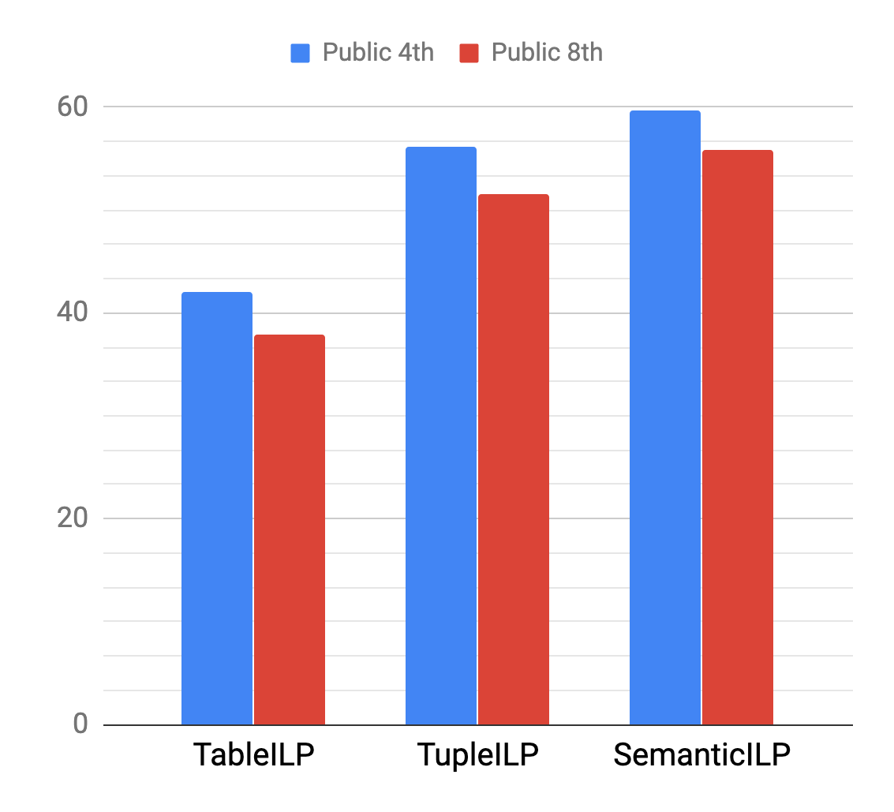
Some Empirical Results
AAAI-2018
ACL-2017
Top scoring systems in their own time.
More details in the related papers
Khot et al, ACL-2017
K et al, AAAI-2018

Slide 31
interim Summary
The importance of the ability to chain information
Structured, Multi-Step Reasoning:
Use science knowledge in small, reusable, swappable pieces
State-of-the-art results on science benchmarks
Benefits of the approach:
Principled approach
Explainable answers

Slide 32
Machine Reasoning [in Aristo]: Today and Future

Slide 33
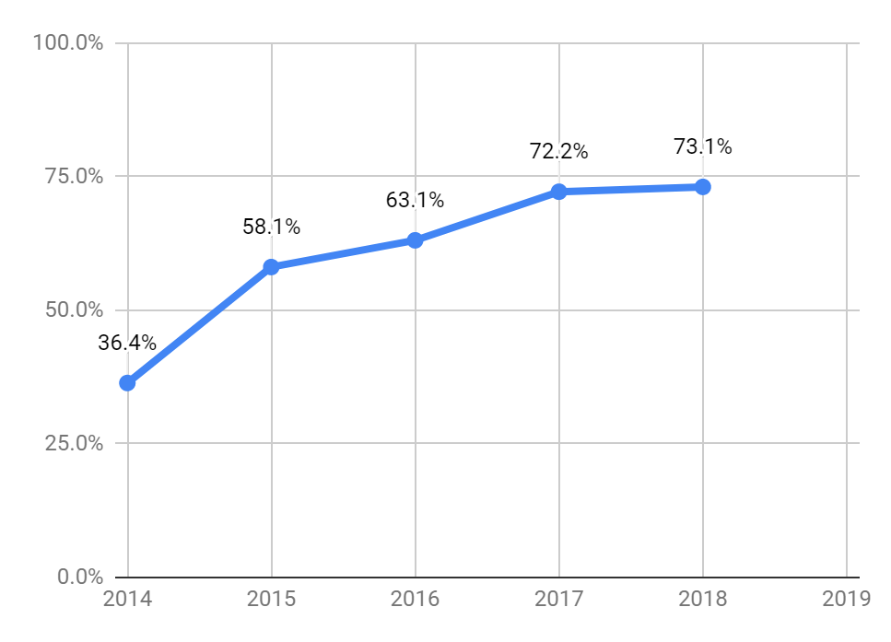
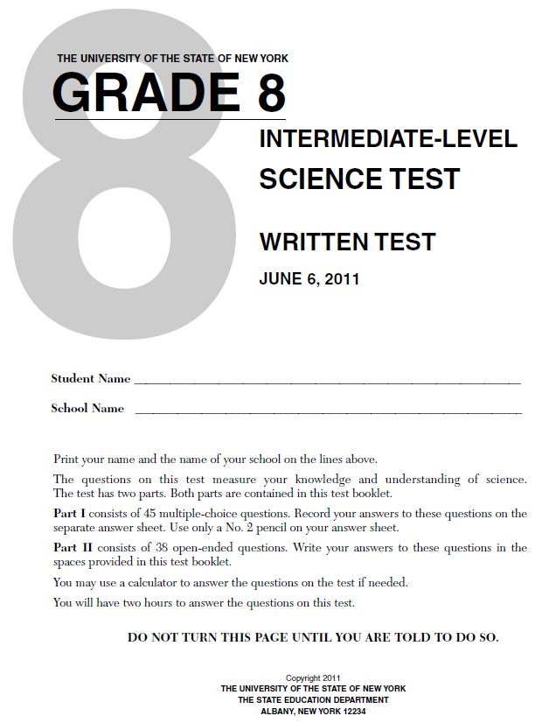
Progression on NY Regents 8th Grade (NDMC)
statistics +
retrieval +
reasoning
(AAAI’16)
tables
baseline
retrieval
methods
(random)
(hidden test set, questions as written, NDMC, 5 years/119 qns)
Notes:
What is our intellectual contribution?
Answering REAL questions, AS WRITTEN, spanning a WIDE VARIETY OF PROBLEMS
A FAMILY OF METHODS for bringing KNOWLEDGE to bear on these PROBLEMS

Slide 34
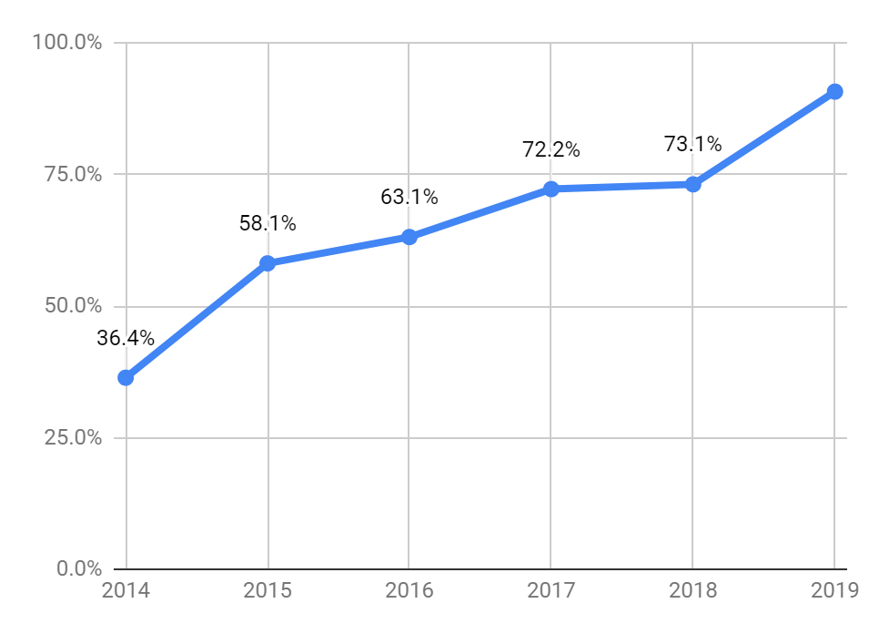
Progression on NY Regents 8th Grade (NDMC)
90.7%
Neural nets
statistics +
retrieval +
reasoning
(AAAI’16)
tables
baseline
retrieval
methods
(random)
Aristo aces 8th grade (non-diagram multiple choice) >90%
(hidden test set, questions as written, NDMC, 5 years/119 qns)
Notes:
What is our intellectual contribution?
Answering REAL questions, AS WRITTEN, spanning a WIDE VARIETY OF PROBLEMS
A FAMILY OF METHODS for bringing KNOWLEDGE to bear on these PROBLEMS

Slide 35
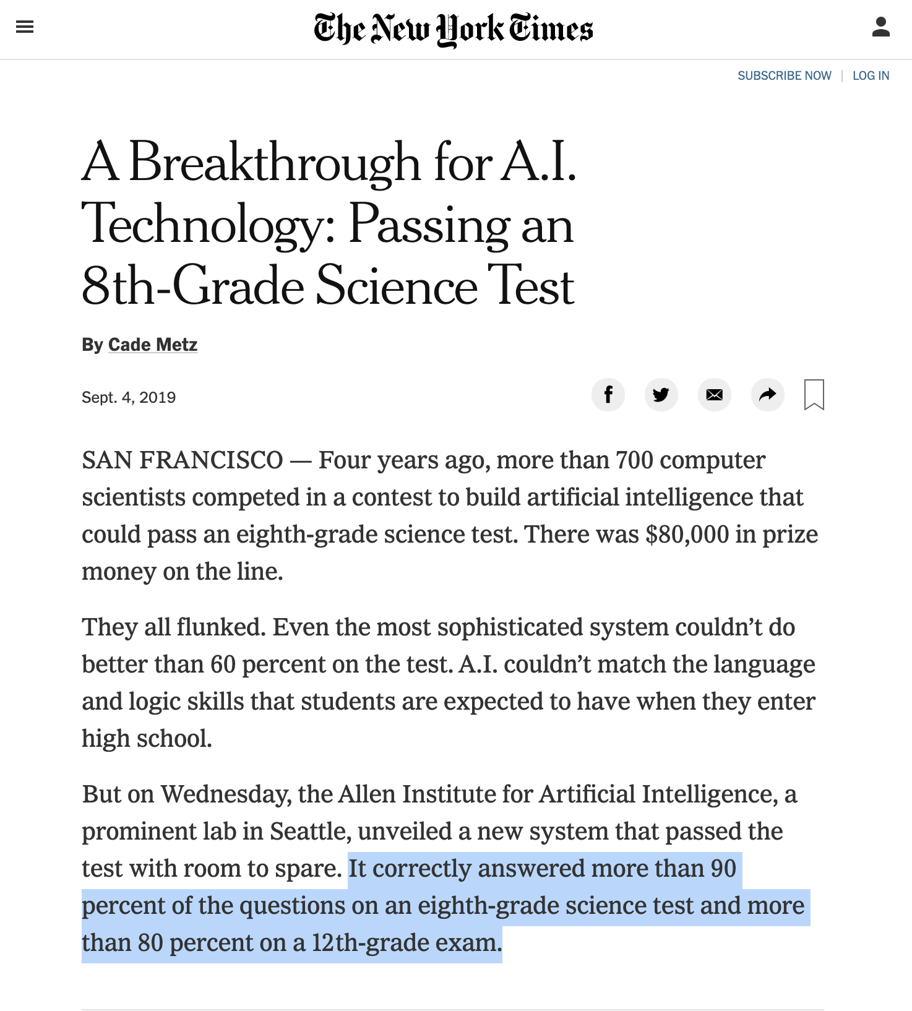
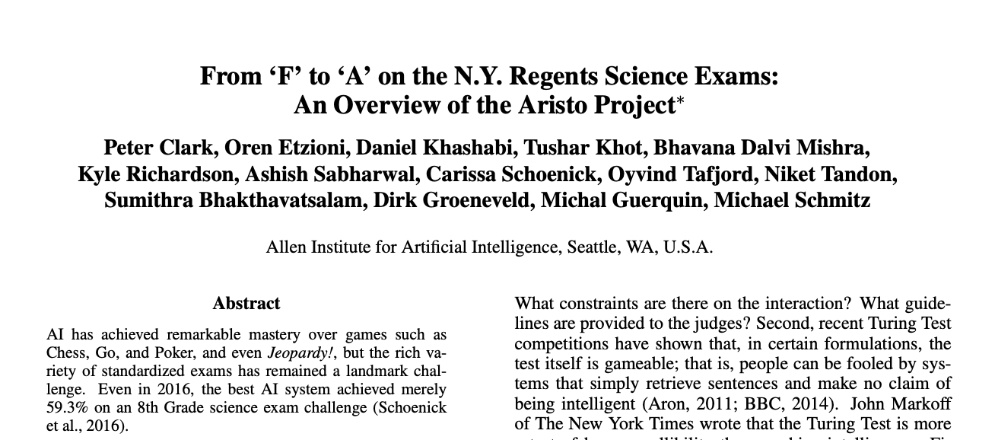
Aristo’s Success
Details in: Clark et al, arXiv-2019

Slide 36
Neural Network solvers for natural language
Big gains are achieved in the past 1-2 years
Not just in Aristo: they have been pretty effective in a wide range of NLP problems
⬤ | ⬤ | ⬤
⬤ | ⬤ | ⬤
⬤ | ⬤ | ⬤
NN
… vacation in Paris …
Many works:
[Peters et al. 18, Devlin et al.18; Radford et al.18, …]

Slide 37
Neural Network solvers for natural language
My view:
An engineering revolution
Concepts and ideas were out there (for decades)
Enabled by:
Big compute:
Having access to many GPUs/TPUs is a must now
Massive pre-training:
Billions are documents are used to tune them
Big supervision:
Availability of more annotated data

Slide 38
Neural Net resurgence

Slide 39
What’s next? What is missing?
Neural Nets have nearly “solved” the science challenges!
Do we understand why?
In many cases, we are not able to explain their decisions.
As a result, we can’t assess the extent of their reliability.
Additionally, extending them is not trivial (largely an open problem)
Accuracy
Neural Nets
Reasoning on Semantic Reps
Transparency Explainability
Extensibility

Slide 40
Aristo: Probing the predictions
City administrators can encourage energy conservation by
(1) lowering parking fees
(2) building larger parking lots
(3) decreasing the cost of gasoline
(4) lowering the cost of bus and subway fares
✓
City administrators can encourage energy conservation by
(1) lowering parking fees
(2) building larger parking lots
(3) decreasing the cost of gasoline
(4) lowering the cost of bus and subway fares
increasing
✓
increasing
So maybe it does actually work? 🤔

Slide 41
Aristo: Probing the predictions
City administrators can encourage energy conservation by
(1) lowering parking fees
(2) building larger parking lots
(3) decreasing the cost of gasoline
(4) lowering the cost of bus and subway fares
✓
City administrators can encourage energy conservation by
(1) lowering parking fees
(2) building larger parking lots
(3) decreasing the cost of gasoline
(4) lowering the cost of bus and subway fares
✘
increasing
availability
Hmm 🤔 … but how should we fix this??

Slide 42
Summary
The Aristo experiment:
Working hypothesis: Real-world language and reasoning capabilities can be assessed via “well-designed” QA tasks.
First systems for science QA effective at multi-hop inference
Can operate with semi-formal knowledge bases
Can fruitfully exploit noisier & less structured representations
Complementary to other methods
Deep learning is playing an important role, but is not everything (yet)
Interacting intelligently with humans remains challenging!
Requires rich linguistic understanding, common sense, domain knowledge, situational awareness, conversational memory …

Slide 43

Questions?
Hiring talented interns, young investigators, researchers, engineers, and more!

Slide 44
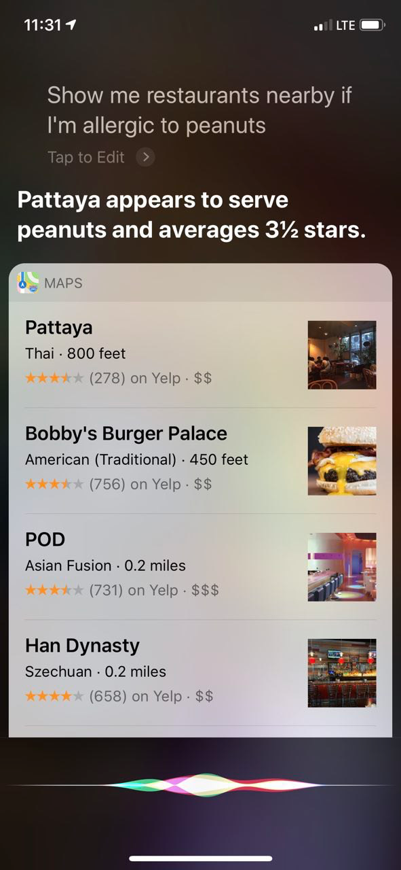


Show me some restaurants nearby.
Here are some options I found nearby:
….
I am allergic to peanuts.
I don’t like crowds.
Notes:
Imagine a conversation with your futuristic natural language assistant.
You ask your system: ....
And it responds by giving a few options. So far, so good, since we have really good retrieval systems that work based on shallow keywords.
But then you remember that you have to specify something else about your order.
For instance you say .....
But how would you go about teaching a machine what “peanut allergy” is and what to do in such situations.
Would you annotate a big pile of training data, in order to teach a machine about “peanut allergy”?
Would that generalize, because there are many other similar phrases that can be used here, instead of peanut allergy.
=================
Even if you do so, I can replace this last query with many other possible replies, each of which require a particular way to address. For instance I can say ...

Slide 45
What needs to happen?
Define representation of functions
Manually author and automatically learn extraction rules
Attack challenges
Linguistic variability
“synthesize protein”, “protein synthesis”, “synthesizes large numbers of proteins”, “helps to synthesize proteins”, …
Multiword expressions
“cell membrane” = “membrane”, but “amino acid” ≠ “acid”
Ambiguous patterns
“cell membrane”, “cell division”, “cell biologist”
Non-functional actions
exist, differ, attempt, do, remain, appear, occur, play, show, …
Peripheral activities
nucleus + divide, ribosome + move
☺
☺
😐
😐
☹

Slide 46
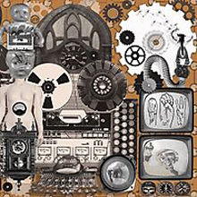


Aristo in Context
Text
candidate
answer
phrases
answer scoring +
evidence
combination
Watson
candidate answer extraction
ranked answers
95%
34%
:
Knowledge Base
(library of ontologies and domain models)
Tractable, probabilistic
Inference
Text
answer
explanation
Aristo
, because
Natural Language
Processing
Knowledge Base
(monolithic,
fixed ontology)
Knowledge
Engineers
Heavy-duty deductive inference
(thereExists ?VAR0
(and
(chemicalReactants-TypeType
CalvinCycle ?VAR1)
(isa ?VAR1 ChemicalCompound
TypeByChemicalSpecies)
(different CarbonDioxide ?VAR1)
(chemicalProducts-TypeType
CalvinCycle ?VAR0)
(genls ?VAR0 CarbohydrateStuff)))
(isa genls TransitiveBinaryPredicate)
(genls Sugar CarbohydrateStuff)
(isa (ChemicalSubstanceFn …
answer
explanation
Cyc
, because
Notes:
Start of Pete’s slides. He said he needs to cut them down and will discuss with you at 1pm today. – Kelli 6/4

Slide 47
Example
QUESTION
Water freezing is an example of a (A) liquid turning into a solid (B) solid turning into a liquid (C) gas turning into a solid
NEW: object(freeze,water) -> d-change(water ,-, liquid, solid)?
object
prop
from
to
explicit representation of discrete change
TEXT
Freezing involves changing water from its liquid state to its solid state by the removal of heat.
freeze -> d-change(water, -, liquid state, solid state).
object
property
from
to

Slide 48
Example
QUESTION
Water freezing is an example of a (A) liquid turning into a solid (B) solid turning into a liquid (C) gas turning into a solid
NEW: object(freeze,water) -> d-change(water ,-, liquid, solid)?
object
prop
from
to
explicit representation of discrete change
TEXT
Freezing involves changing water from its liquid state to its solid state by the removal of heat.
freeze -> d-change(water, -, liquid state, solid state).
object
property
from
to

Slide 49
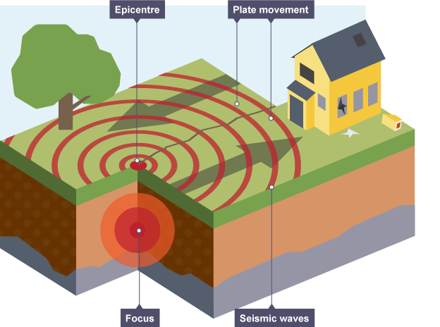

REASONING
What do earthquakes tell scientists about the history of the planet?
(A) Earth's climate is constantly changing.
(B) The continents of Earth are continually moving.
(C) Dinosaurs became extinct about 65 million years ago.
(D) The oceans are much deeper today than millions of years ago.
Notes:
This example requires a bit more reasoning, and none of the participants’ models got it right.
READ QUESTION
This question requires you to consider the process by which earthquakes occur and what this might mean for the planet itself.
What does Aristo choose?
Aristo goes for option C, Dinosaurs became extinct about 65 million years ago.

Slide 50

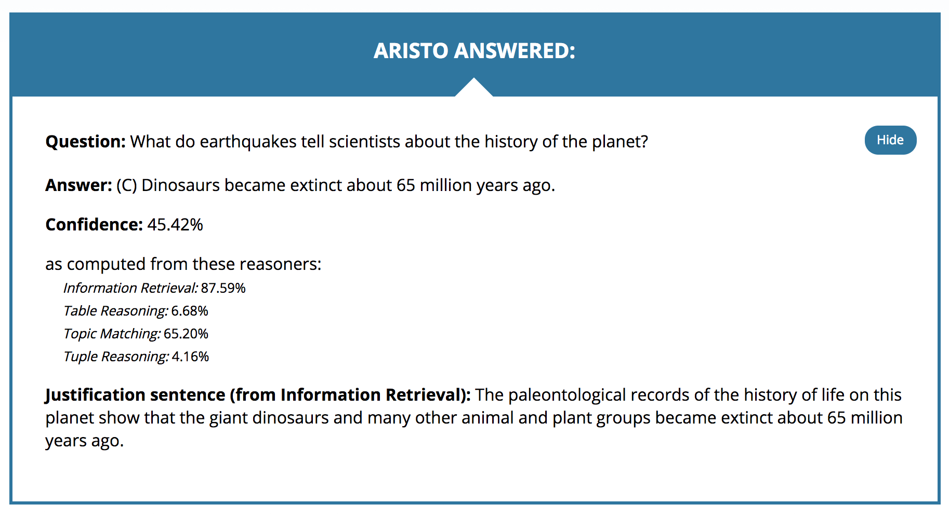
REASONING
Notes:
Aristo chooses this answer because it finds extremely strong support for this statement from our various sources of science text.
This statement about dinosaurs is in fact true, so it’s an especially tricky task to recognize that while it may be true, it’s not relevant to the concept the question is addressing.

Slide 51
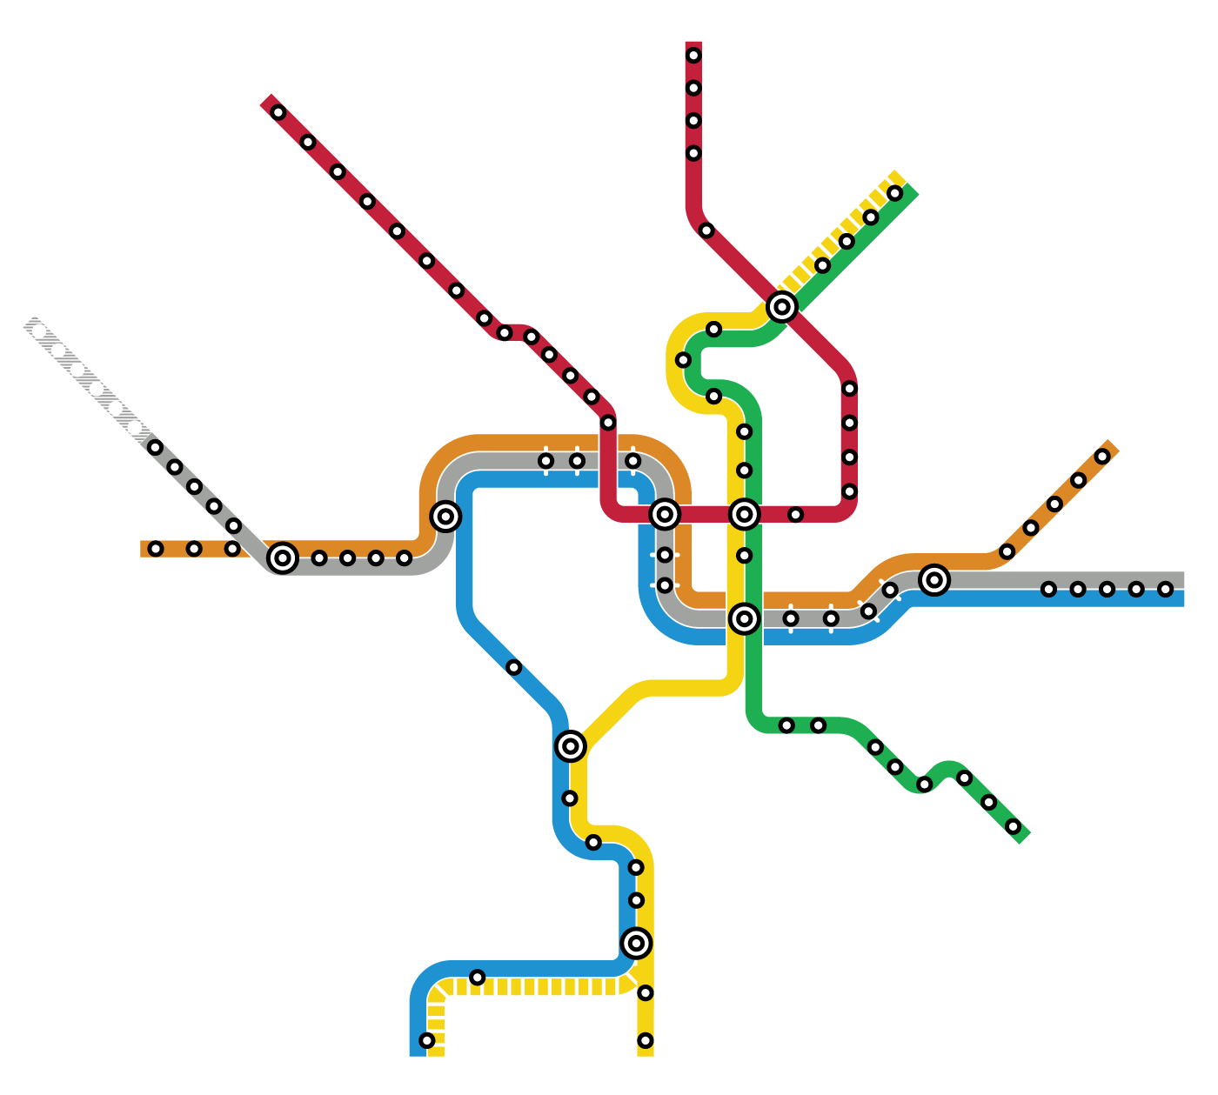
COMMON SENSE
City administrators can encourage energy conservation by
(A) lowering parking fees
(B) building larger parking lots
(C) decreasing the cost of gasoline
(D) lowering the cost of bus and subway fares
Notes:
Here’s an example none of the challenge winners’ models got right. This particular question relies heavily on common sense knowledge.
READ QUESTION
This is a challenging question because it requires the common-sense knowledge that certain activities like cost reduction are incentives that affect human behavior,
And that certain human behaviors result in more or less energy being consumed.
Understanding the question also requires the system being able to recognize that "energy" in this context refers to resource consumption for the purposes of transportation, as opposed to other forms of energy one might find in a science exam (such as electrical and kinetic/potential).

Slide 52
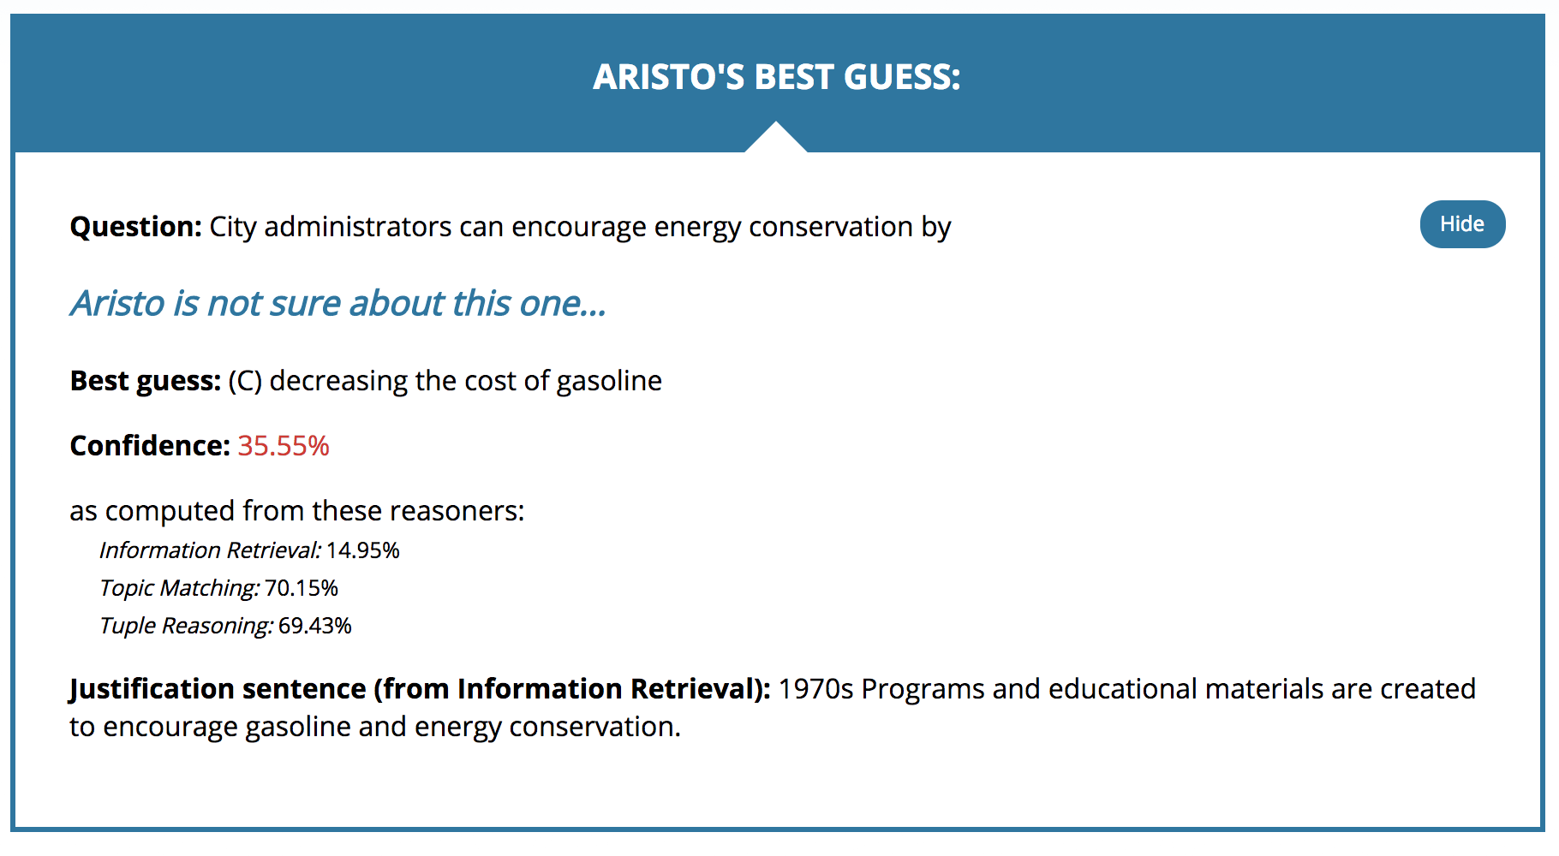
COMMON SENSE
Notes:
Aristo didn’t get this right either!
The system found some supporting suggestion of the phrases “gasoline” and “energy conservation” together in our corpus but couldn’t otherwise make the necessary connections to reason through this question.

Slide 53
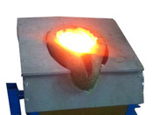
Reasoning to an Answer: Qualitative Relations
How are the particles in a block of iron affected when the block is melted?
(A) The particles gain mass.
(B) The particles contain less energy.
(C) The particles move more rapidly.
(D) The particles increase in volume.

Slide 54
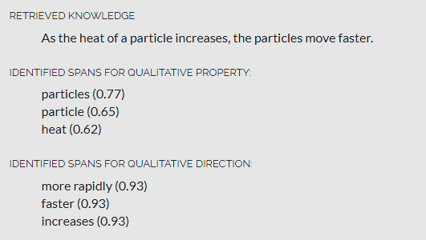

Reasoning to an Answer: Qualitative Relations
How are the particles in a block of iron affected when the block is melted?
(A) The particles gain mass.
(B) The particles contain less energy.
(C) The particles move more rapidly.
(D) The particles increase in volume.
Retrieved knowledge

Slide 55
Reasoning to an Answer: Qualitative Relations
How are the particles in a block of iron affected when the block is melted?
(A) The particles gain mass.
(B) The particles contain less energy.
(C) The particles move more rapidly.
(D) The particles increase in volume.
Retrieved knowledge
Application to question

Slide 56
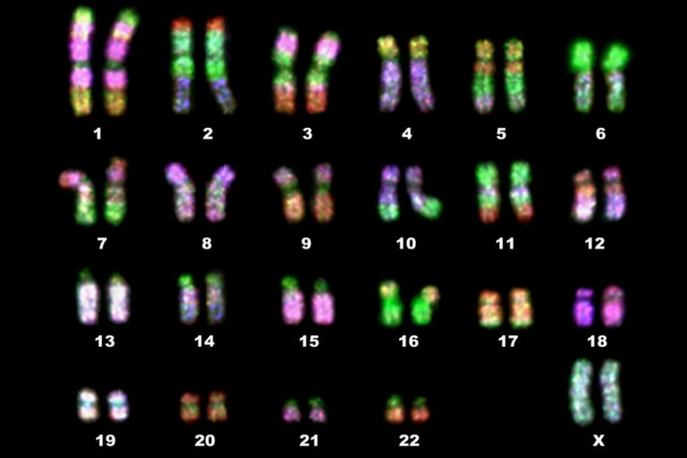
Example Question: Simple Lookup
How many chromosomes does
the human body cell contain?
(A) 23
(B) 32
(C) 46
(D) 64
Notes:
Here is an example of a question that both Aristo and the Allen AI science challenge contestants got correct because this information is clearly available in various science texts
READ QUESTION
Our systems can easily match the question to this knowledge without extra reasoning required.
Anyone know this one?

Slide 57
Example Question: Reasoning by Chaining
Aristo KB facts:
Which features are the best evidence that glaciers once covered an area?
(A) wide riverbeds
(B) U-shaped valleys
(C) groundwater springs
(D) underground caves
(glacier, causes, glacial erosion)
&
(glacial erosion, causes, valley)
→ (glacier, causes, valley)
Notes:
Aristo is gaining reasoning capabilities, however.
Here is an example question that was not reliably answer correctly by the challenge participants models.
READ QUESTION
In this case, Aristo successfully chains two facts from its knowledge base together to arrive at the right answer, demonstrating simple reasoning.
CLICK THROUGH FACTS
This represents the first steps toward recognizing the relevant information a question requires and putting it together the right way to produce a reasoned response.

Slide 58
Me @ AI2
Been working with Allen Institute for AI (AI2)
On-and-off since 2015, and full-time since this August.
AI2:
Mission: AI for Common Good
Projects:
Natural Language Processing
Computer Vision
AI and Fairness
etc.

Slide 59
Handling Lexical Variability
Knowledge is expressed in a variety of linguistic forms
Simple textual variation confuses even the best solvers
No single knowledge representation (e.g., Open IE tuples) suffices
Idea: Reason over (multiple) semantic abstractions of text
Use off-the-shelf, pre-trained NLP modules
Multiple views for a more complete semantic understanding
SRL frames (verbs, prepositions, comma), dependency parse, coreference sets, lexical similarity links, raw text sequence
Unified representation as a family of Semantic Graphs
PredArg graphs, trees, clusters, sequences
Connected via textual similarity links
Same ILP-based reasoning formalism as before
AAAI-2018
ACL-2017

